Slide 1


DEPARTMENT OF COMPUTER SCIENCE AND ENGINEERING
20CS7503 & DESIGN PROJECT – III
END SEMESTER PRACTICAL EXAMINATION- NOV / DEC 2025
REVIEW PRESENTATION
Batch No.:9
Date: 28/11/2025
Session:FN

Slide 2
YOUTUBE VIDEO SUMMARIZER USING NATURAL LANGUAGE PROCESSING
Guide Name:
Ms. S.UMA MAGESHWARI, M.E.,
AP/CSE
Team Members:
R.P.KAVIN KIRTHIK (811722104071)
A.K. NIKHAAL AHAMED (811722104101)
P.RAGHUL (811722104116)

Slide 3
OBJECTIVE OF THE PROJECT
Develop a system to automatically summarise YouTube videos using NLP.
Enhance accessibility and content navigation by providing concise summaries.
Compare extractive and abstractive summarisation techniques for accuracy.

Slide 4
INTRODUCTION
Over 500 hours of video are uploaded to YouTube every minute.
Manual content browsing is time‑consuming.
Automated summarisation can help users quickly grasp video content.
NLP processes transcripts, captions, and metadata to generate summaries.
Aim: Build a robust and accurate video summarisation system.

Slide 5
LITERATURE SURVEY
TITLE | AUTHORS | PUBLISHER | TECHNOLOGY USED
Method of Text Summarization using LSA and BERT | Hritvik Gupta & Mayank Patel | IEEE ICAIS 2021 (International AI Conference) | LSA, TF-IDF, BERT
Extractive Automatic Text Summarization using SpaCy | Swaranjali Jugran, Ashish Kumar, Bhupendra S. Tyagi, Vivek Anand | ICACITE 2021 (IEEE International Conference) | SpaCy, Python NLP (extractive)
ASoVS: Abstractive Summarization of Video Sequences | Aniqa Dilawari; Muhammad Usman Ghani Khan | EEE Access 7 (2019): 29253–29263 | Deep Neural Networks
Fully Convolutional Sequence Networks | Mrigank Rochan; Linwei Ye; Yang Wang. | ECCV (2018): 347–363 | CNN‑based Seq. Models
Unsupervised Video Summarization with Adversarial LSTM Networks (SUM-GAN) | Behrooz Mahasseni; Michael Lam; Sinisa Todorovic | CVPR 2017 | GAN framework: LSTM summarizer + LSTM discriminator (unsupervised).
Deep RL for Unsupervised Video Summarization | Kaiyang Zhou; Yu Qiao; Tao Xiang | AAAI (2018) | BiRNN/DSN trained with reinforcement learning using DR reward (unsupervised)

Slide 6




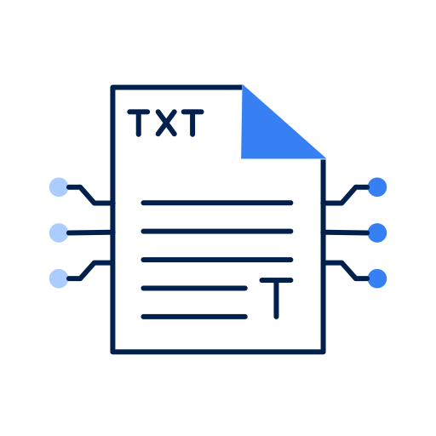
EXISTING SYSTEM ARCHITECTURE
VIDEO INPUT
VIDEO PROCESSING NLP
FEATURE EXTRACTION
SUMMARIZED TEXT
TEXT GENERATION

Slide 7
PROBLEM IDENTIFICAITON
Users find it difficult and time-consuming to watch lengthy YouTube videos to extract key information.
Manual summarization of videos or transcripts is inefficient and prone to human error.
Existing tools focus mainly on text summarization, not on processing full video or audio content.
Lack of an integrated system that combines transcription, NLP-based summarization, and user interface for easy access.
Difficulty in maintaining summary accuracy and context when converting spoken content into concise text form.

Slide 8





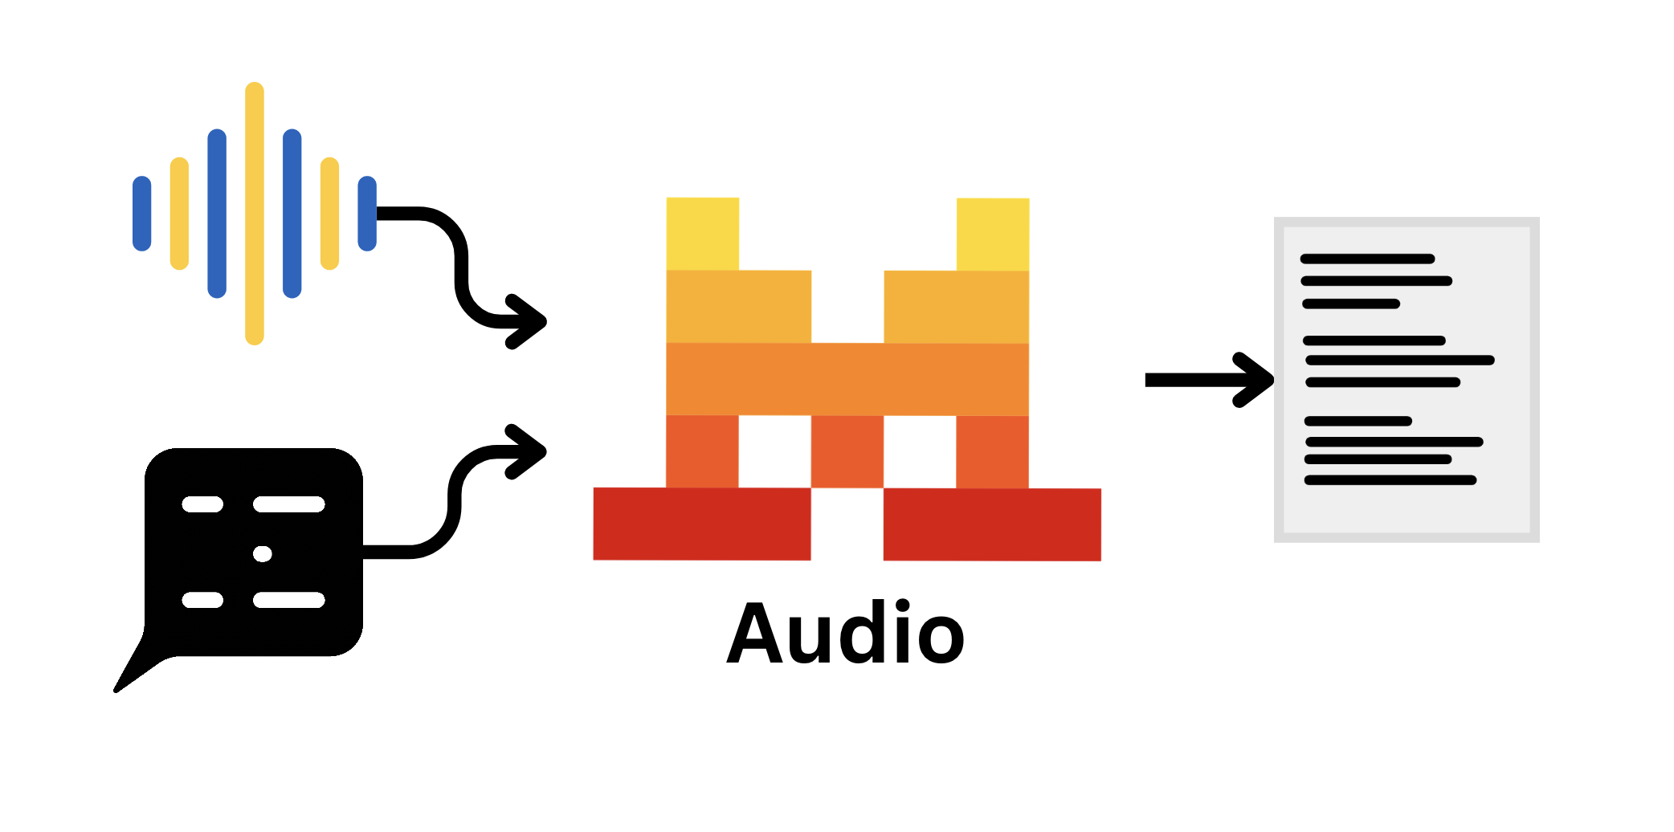
PROPOSED SYSTEM ARCHITECTURE
HUMAN INTERVENTION OR UI
UNITY INTERACT WITH PYTHON
PYTHON FETCH VEDIO FROM LOCAL DIRECTORY (IPC)
OUTPUT IN NOTEPAD
TRANSCRIPT SUMMARY ON VIDEO
WHISPER AI FOR TRANSCRIPTION

Slide 9
SOFTWARE AND HARDWARE REQUIREMENTS
SOFTWARE
Python 3.x
Ollama
HuggingFace
Unity
HARDWARE
Intel i5/i7 or higher
8–16 GB RAM
GPU support for deep learning

Slide 10
MODULES
Video Data Collection & Preprocessing
Audio & Transcript Extraction
Text Preprocessing
Summarization Engine
Output Generation Interface

Slide 11
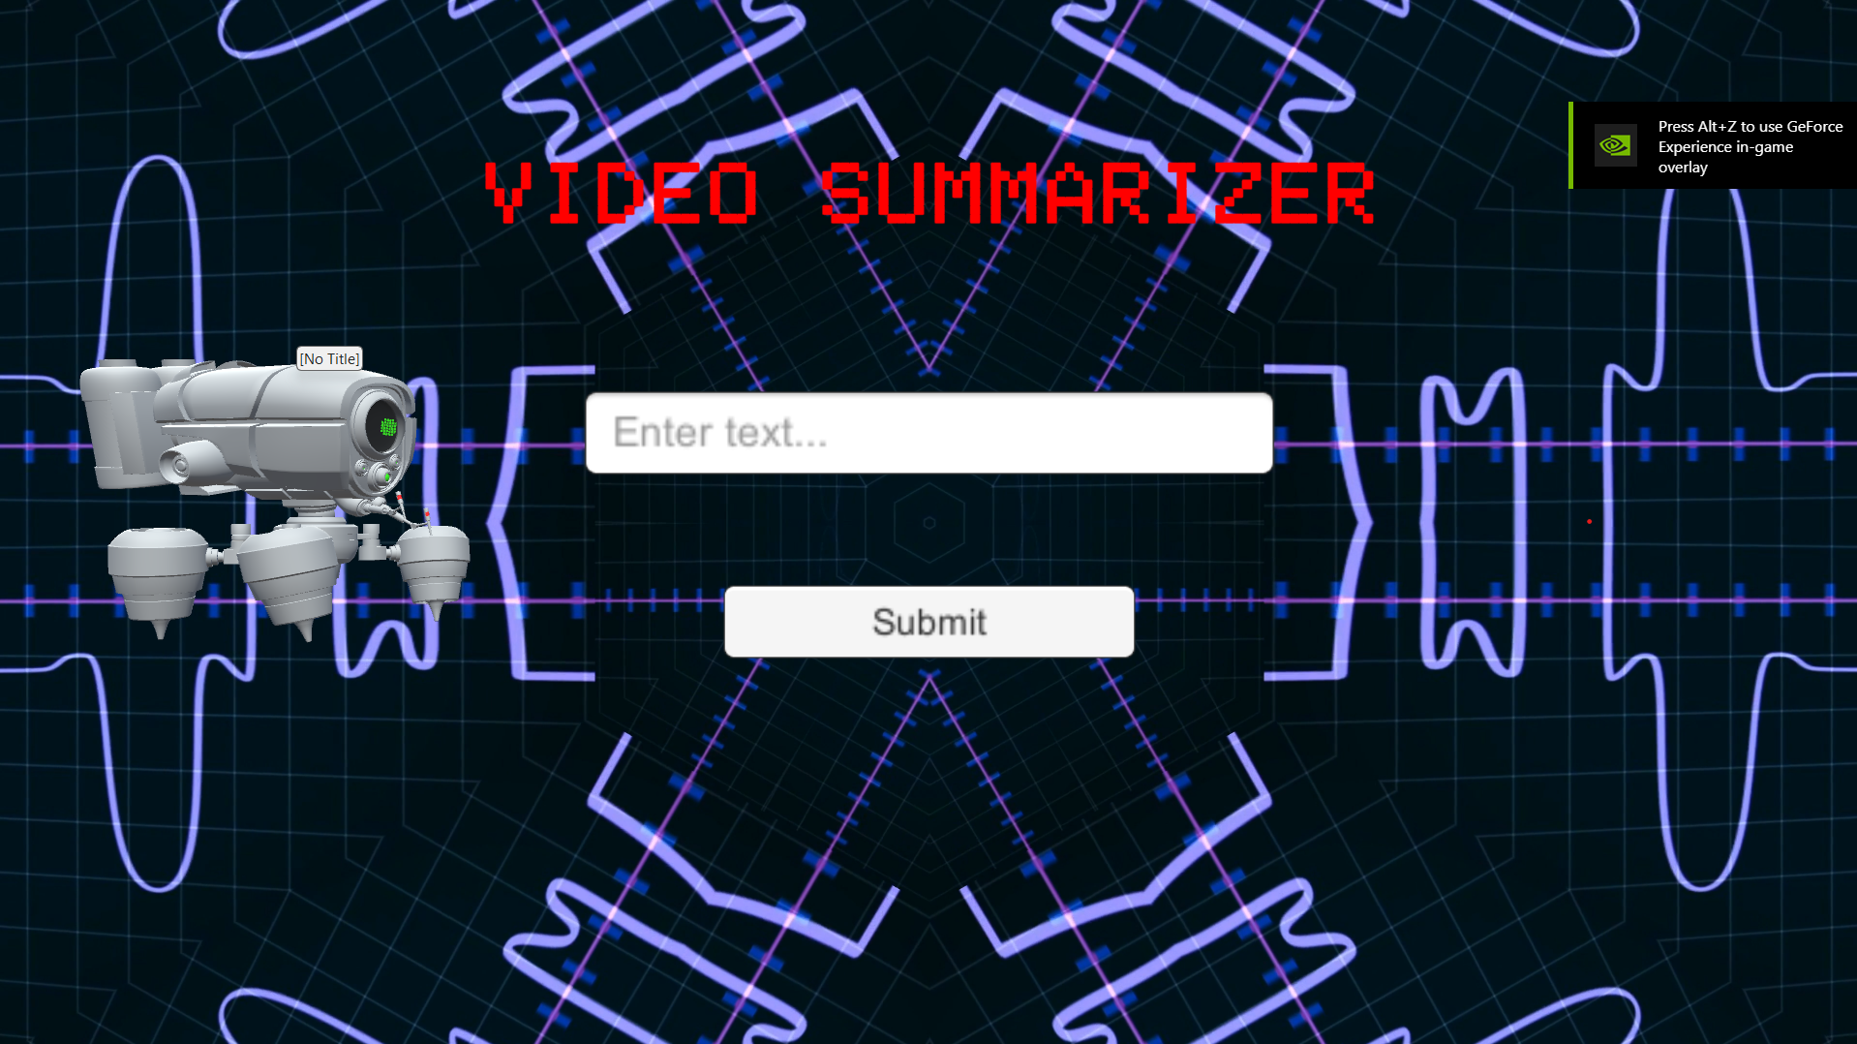
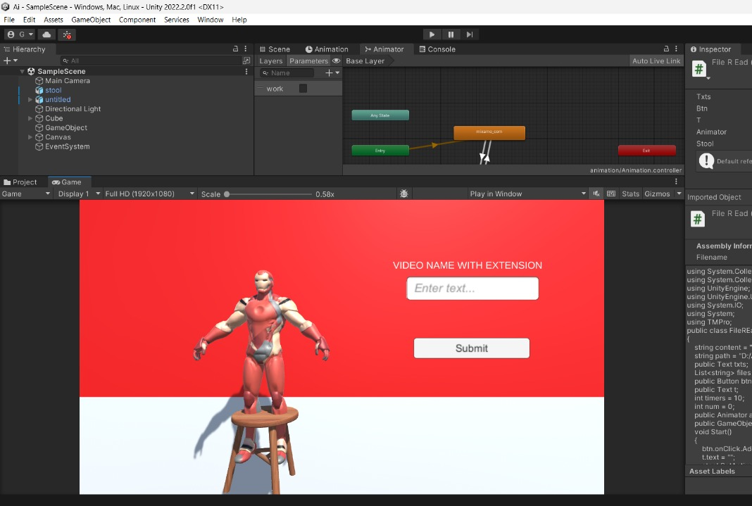
IMPLEMENTATION OF MODULE-1
This Video is downloaded via tube mate.
Then using unity UI we need to enter the location
of the video
Fetch text through (IPC)

Slide 12
IMPLEMENTATION OF MODULE-2
Remove background noise from audio for clear transcription.
Eliminate stopwords and punctuation for cleaner text.
Apply tokenization for splitting text into meaningful units.
Perform lemmatization using SpaCy/NLTK to normalize words.

Slide 13
IMPLEMENTATION OF MODULE-3
Implement extractive summarization using BERT embeddings.
Rank sentences based on semantic similarity and importance.
Use transformer models (Mistral) for abstractive summarization.
Compare extractive vs. abstractive outputs for accuracy.

Slide 14
IMPLEMENTATION OF MODULE-4
Integrate NLP pipeline with Ollama and pretrained transformers.
Perform context-aware summarization with Whisper AI inputs.
Combine extractive and abstractive summaries for better results.
Optimize summaries to retain meaning while reducing redundancy.

Slide 15
IMPLEMENTATION OF MODULE-5
Present summaries via a simple, user-friendly UI.
Allow users to export results in .txt format.
Backend implemented in Python with request module.
Provide seamless interaction between modules for smooth user experience.

Slide 16
CONCLUSION
The system employed to generate summaries for lengthy YouTube videos is designed to save time and provide users with a quick yet accurate understanding of the content.
This system utilizes a combination of two distinct Natural Language Processing (NLP) techniques.extractive summarization and abstractive summarization.
By integrating both methods, it ensures the generated summaries.
Maintain high contextual accuracy while also being concise and coherent. the same sentence with bulletin

Slide 17
FUTURE ENHANCEMENTS
Add multilingual support for diverse languages.
Enable real-time summarization during streaming.
Enhance summary accuracy using transformer models.

